Slide 1

Code Writer On The Go
Daniel Ashley & Gerald Washington II
Columbus State University

Slide 2
Goals of the Application
Provide an offline mobile Code Editor
Highlights key words for different languages
Allows emailing of typed code to yourself as well as to others
Allow privacy for users when writing and sending code via a user login screen
Store, read, and write code

Slide 3
What the Application is
A convenient way to create code on the go
An enhanced text editor made for the specific purpose of making code in Java and in C
A simple and effective way to edit and save code and send it to others

Slide 4
What the Application is NOT
The application is NOT a IDE or compiler
Can not execute or run code itself
Only highlights select API key terms

Slide 5
Why a mobile text editor?
Most Programmers are bound to desktops and laptops that require time to boot themselves and launch an application.
Creating a code editor for android phones provides a more convenient method of coding able to be accessed by anyone with a smart phone.

Slide 6
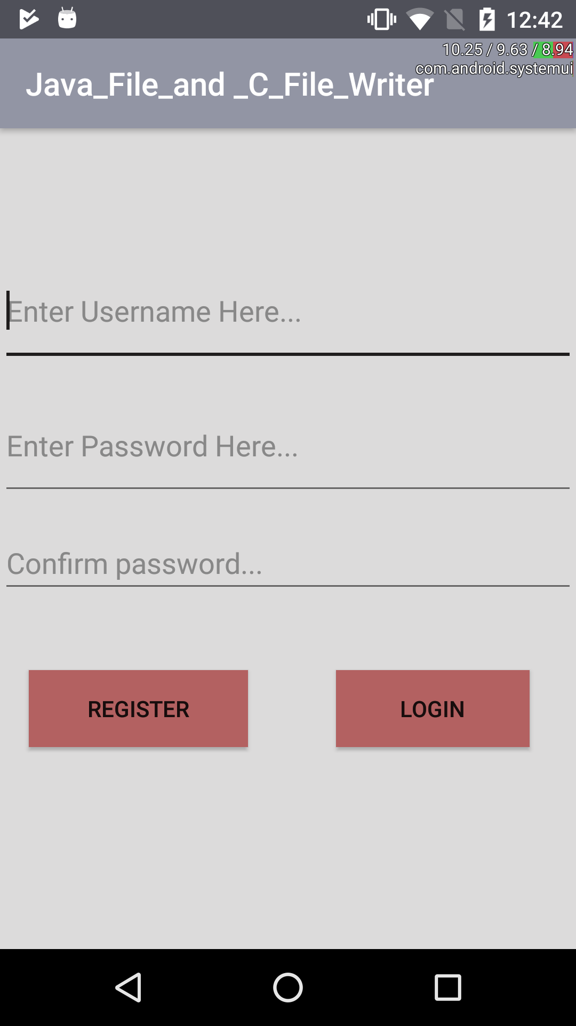
Running the Application: Registration
The user login is stored locally on the phone.
No internet connection used what so ever
The login information is privatized so none can access another user’s login data
Registering only creates a login credential

Slide 7
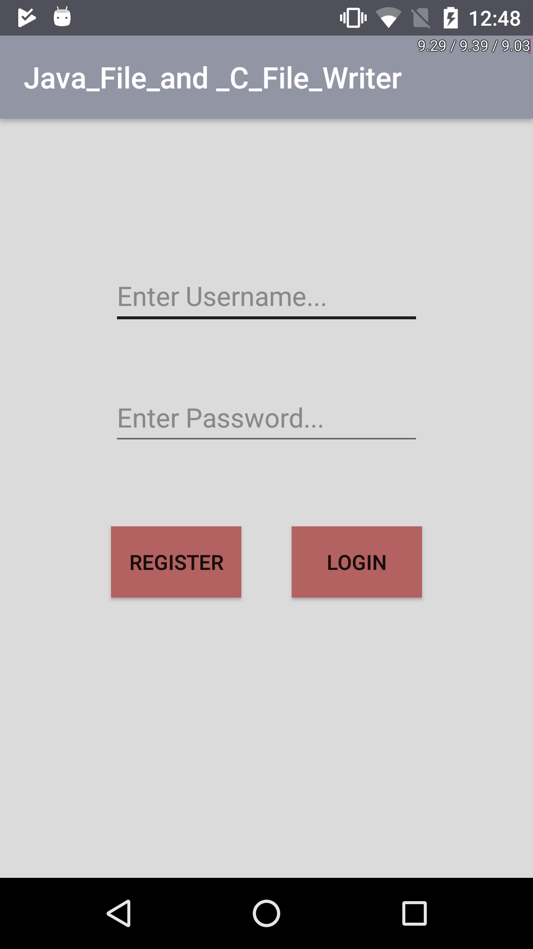
Running the Application: Logging In
Once a user has made their username and password, clicking the Login button on the Register page will take you to this login page.
The newly registered user or returning user will enter their user name and password to gain access
If the user has not registered before they come to this screen, then the REGISTER button will take them back to the Register Screen.

Slide 8
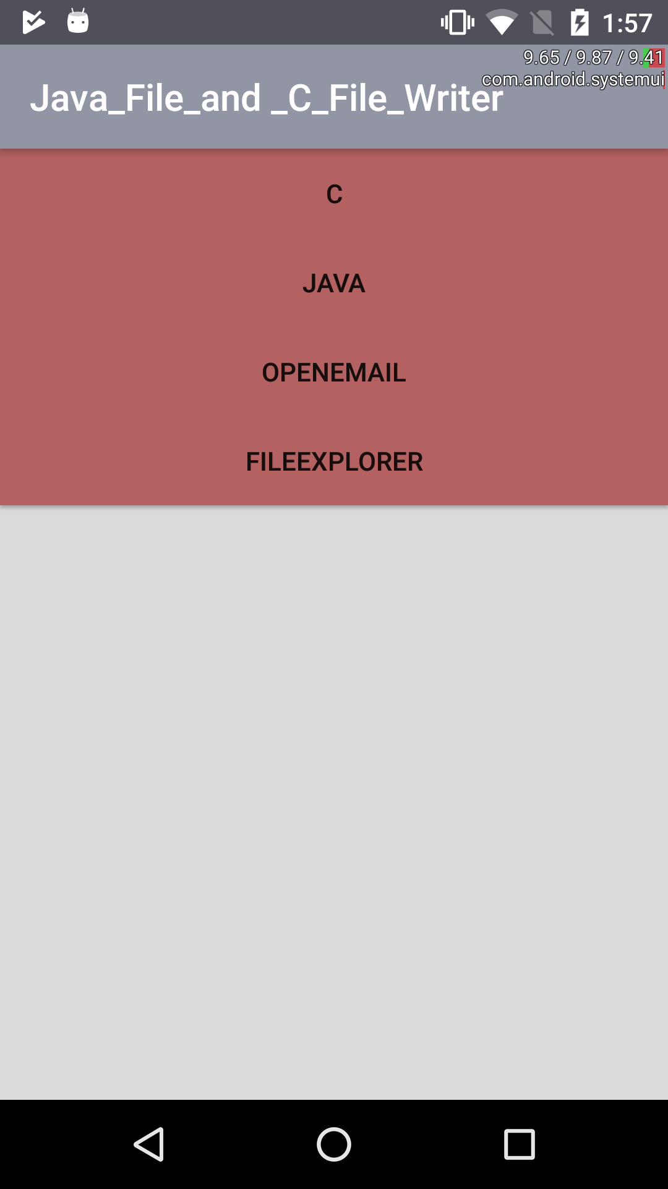
Running the Application: Choices
On this Screen you are provided four options, each preforming a particular task:
C: Opens the code editor for C language
Java: Opens the Java code editor
Email: Opens an Email if you wish to email without code.
FileExplorer: Displays the internal storage for the phone, allowing a user to access any files necessary.

Slide 9
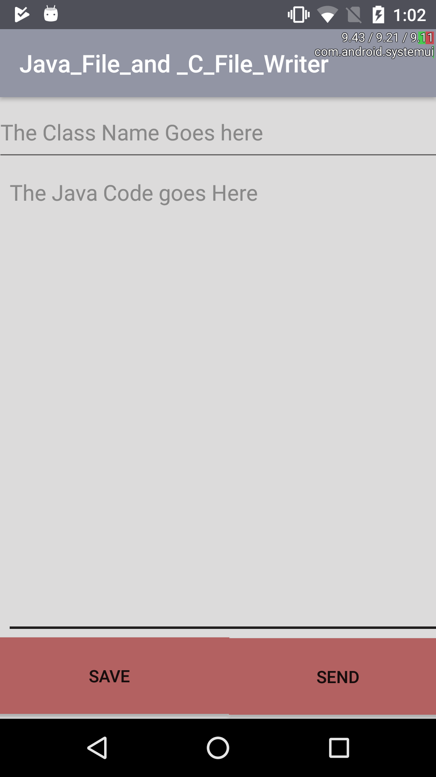
Running the Application: Java/C Editors
Selecting the Java or C buttons brings users to a screen like this. Depending on the language choice, the editor highlights keywords as you type in the code portion.
The save button will save the class in a corresponding language format depending on the prior language choice. (ex., “class.java”, “class.c”)
The send button creates an email with the given class name in the subject line, and code written will become to body of the email.

Slide 10
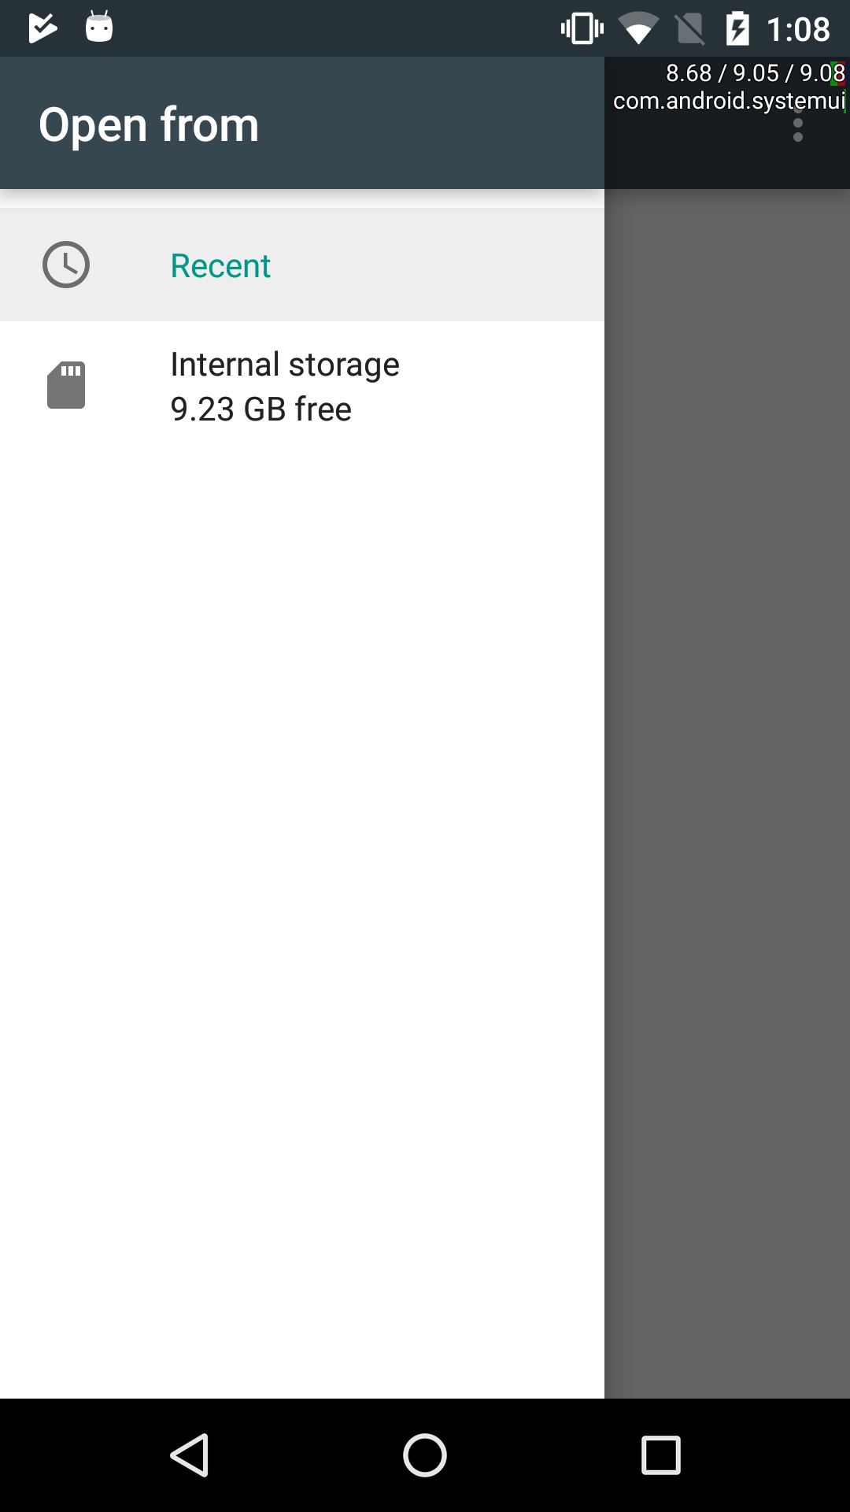
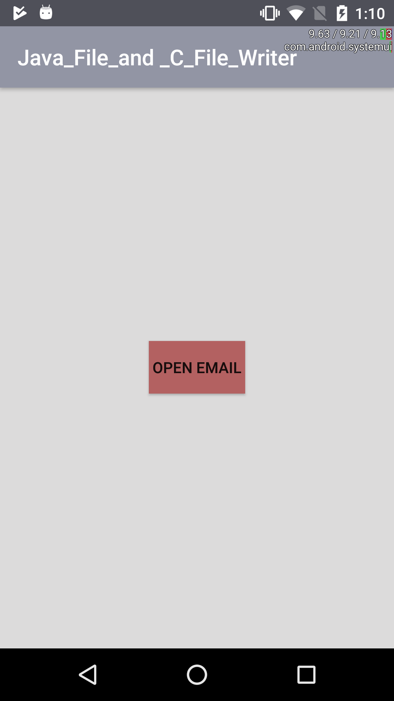
Running the Application: Email and File Explorer
The FileExplorer and OpenEmail buttons open the File Explorer (left) and the email screen (right), respectively
For FileExplorer you can open the internal storage and choose a file
As for Email you can write and send a basic email

Slide 11
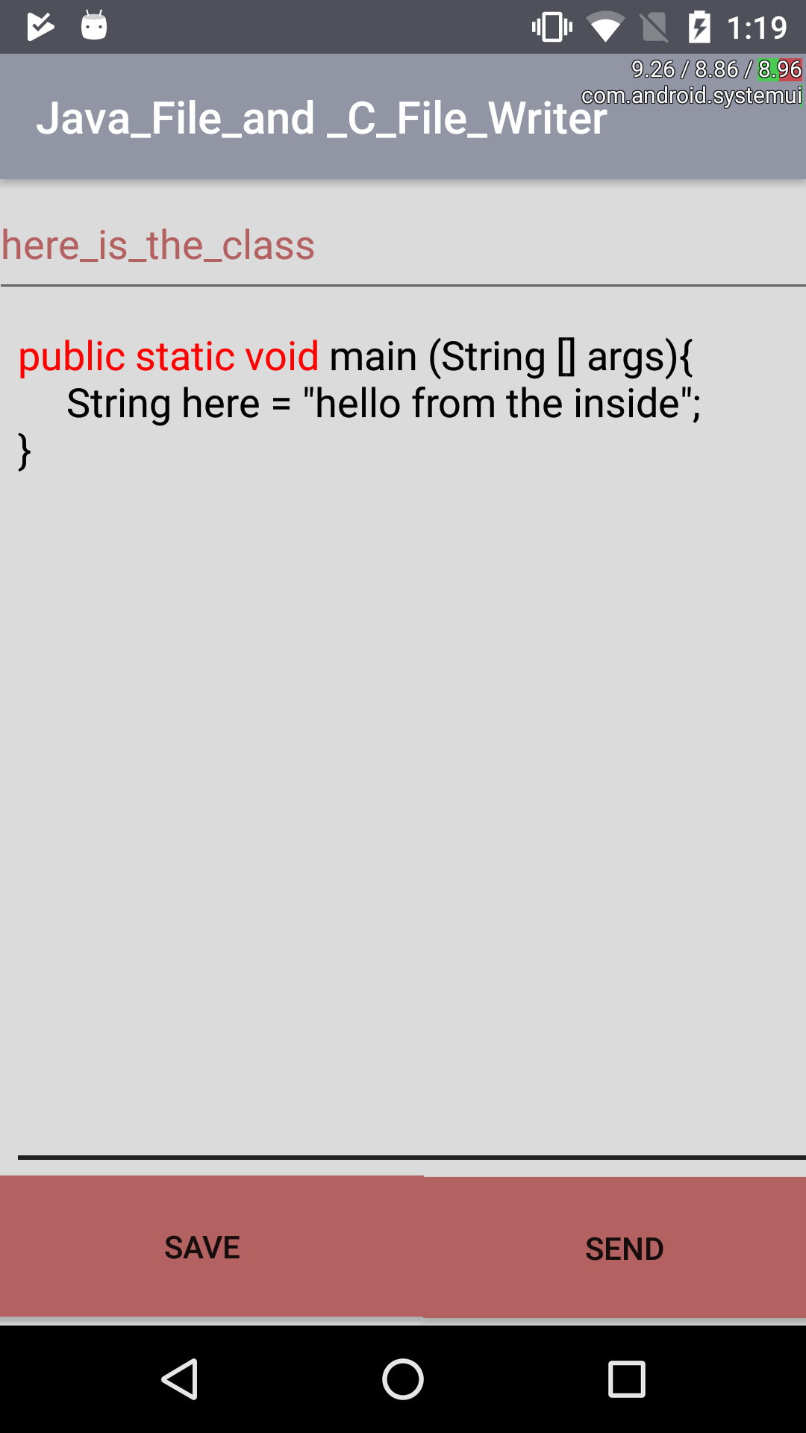
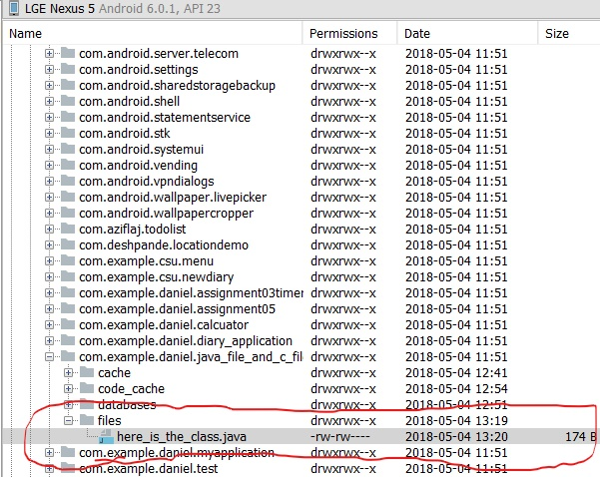
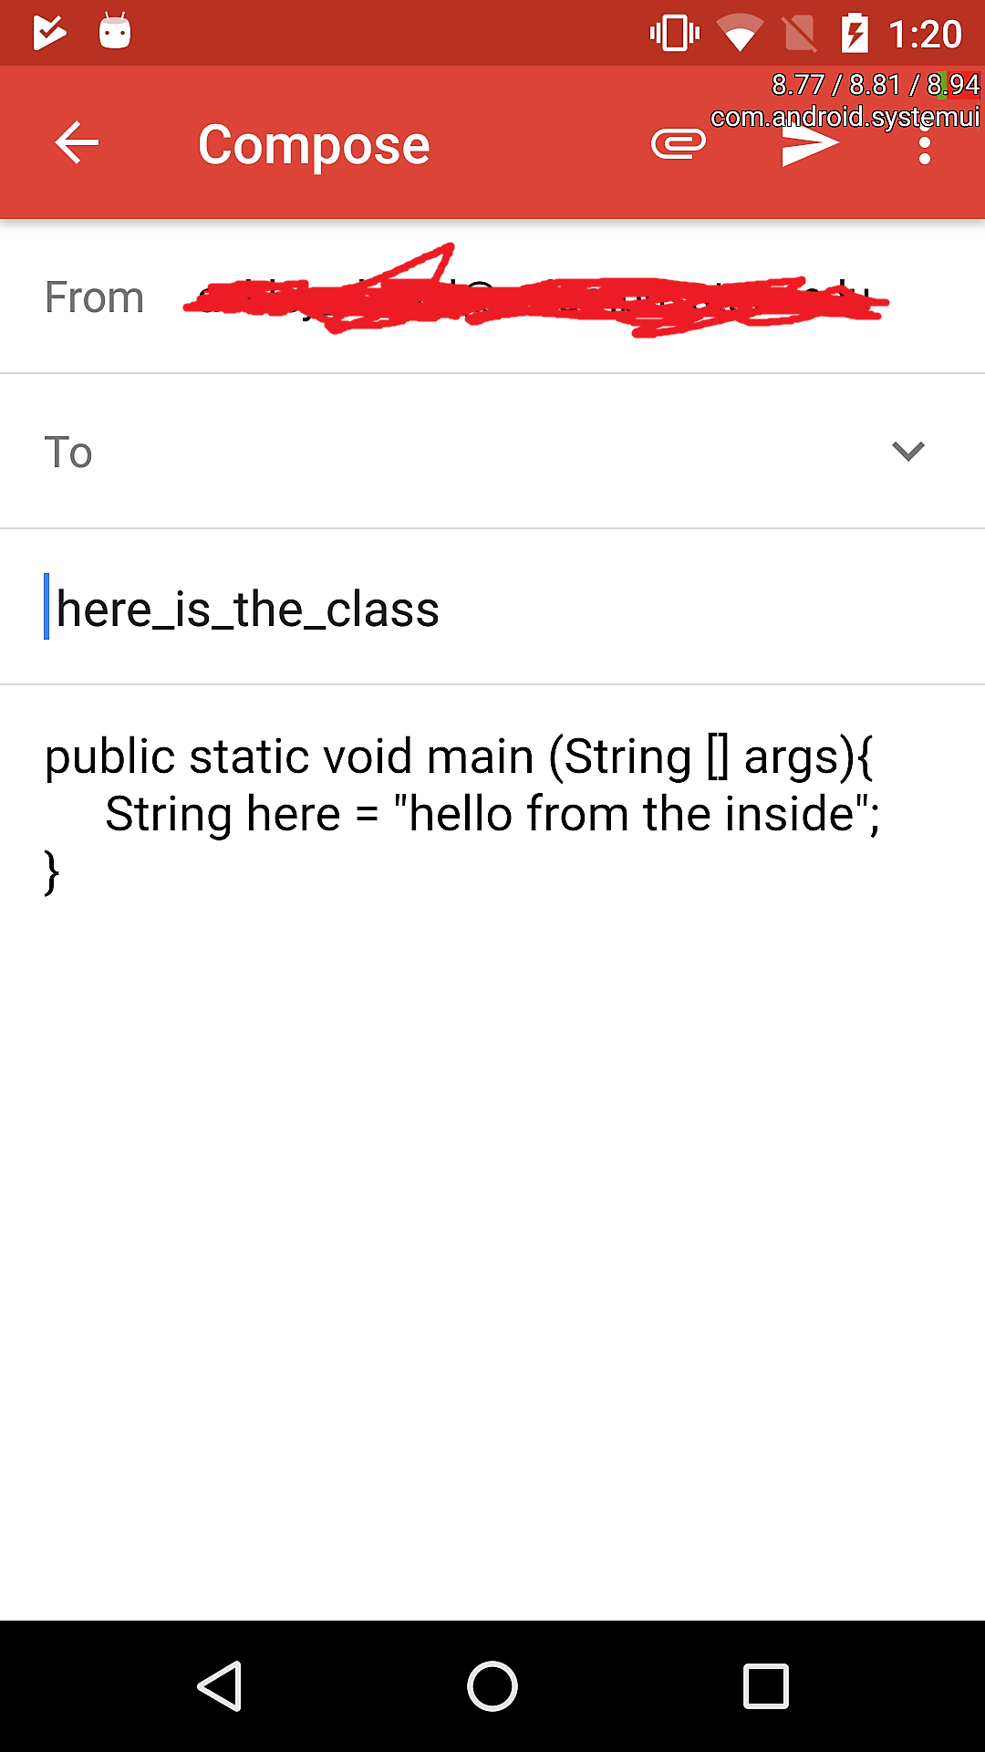
The Highlighter
Samples of:
The editor’s active highlighter
Code saved to the internal storage of the phone
Results of what the send button does.

Slide 12
What was Accomplished?
What was created was a active text editor
A way to share and save code from users
And a secure application that accesses the phones internal email client to send code.

Slide 13
Our Future Plans
Add More Languages
Providing a way for a specific user to show only his/her files only and not have others be able to access them
Improve the editor to handle more language specific characters such as {} or types such as String or #include

Slide 14
